Slide 1
PeopleTools 8.54 for the Oracle DBA
David Kurtz
Go-Faster Consultancy Ltd.
david.kurtz@go-faster.co.uk
www.go-faster.co.uk

Slide 2



Who Am I?
Oracle Database Specialist
PeopleSoft
  Independent consultant
Performance tuning
  PeopleSoft ERP
  Oracle RDBMS
Book
  www.psftdba.com
Oak Table
.
Notes:
2
©2011 Go-Faster Consultancy Ltd. www.go-faster.co.uk
Row Migration can Aggravate Contention on Cache Buffer Chains Latch
30/03/2015

Slide 3
Resources
The presentation is available from
    http://www.go-faster.co.uk
It started out as a series of blog postings
  http://blog.psftdba.com/2015/02/peopletools-854-for-oracle-dba.html
  http://blog.psftdba.com/search/label/PeopleTools 8.54

Slide 4
Agenda
There is lots of new stuff in PeopleTools 8.54.
  Fluid UI
  Graphical Reporting
  Upgrade & Configuration management
  Security enhancements
This presentation looks at support for Oracle database performance features

Slide 5
Agenda
Descending Key Indexes
Materialised Views
Global Temporary Tables
Partitioning
%SQLHint Meta-SQL
%SelectDummyTable Meta-SQL
Multiple Security Records
Oracle Resource Manager
Performance Monitor enhancements
EnableAEMonitoring

Slide 6
Descending Indexes
They have gone again!
  Originally, descending fields → descending columns in key indexes
  PT8.14 ascending indexes due to bug in Oracle 8i
  PT8.48 descending indexes reinstated. First version not certified below Oracle 9i
  PT8.54 only ascending indexes built. Including user indexes.

Slide 7
Does it matter?
Index leaf nodes are chained in both directions.
  So a descending index can be used for an ascending scan and vice versa
Min/max range scan optimisation
  Doesn’t work with descending indexes
  Ascending index can be slightly better

Slide 8
Ascending Scan Descending Index
WHERE name <=‘Clark’
Descending indexes use sys_op_descend()
Turner
King
Ward
Smith
Martin
Jones
Ford
Allen
Ward
Turner
Smith
Scott
Miller
Martin
King
Jones
James
Ford
Clark
Blake
Allen
Adams

Slide 9
Ascending Index Scan
WHERE name <=‘Clark’
Adams
King
Adams
Blake
James
King
Miller
Turner
Adams
Allen
Blake
Clark
Ford
James
Jones
King
Martin
Miller
Scott
Smith
Turner
Ward
Notes:
set autotrace off
drop table t purge
/
create table t
(name varchar2(30) not null
,padding varchar2(4000)
)
/
insert into t
with x as (
select 'Adams' name, 4000 padlen from dual
union all select 'Allen', 4000 from dual
union all select 'Blake', 2000 from dual
union all select 'Clark', 2000 from dual
union all select 'Ford', 2000 from dual
union all select 'James', 4000 from dual
union all select 'Jones', 4000 from dual
union all select 'King', 4000 from dual
union all select 'Martin', 4000 from dual
union all select 'Miller', 2000 from dual
union all select 'Scott', 2000 from dual
union all select 'Smith', 2000 from dual
union all select 'Turner', 4000 from dual
union all select 'Ward', 4000 from dual
)
select name, rpad(name,padlen,'.') from x
/
create unique index ta on t(name, padding)
/
create unique index td on t(name DESC, padding)
/
set autotrace on
alter session set optimizer_features_enable='8.0.3';
clear screen
select /*+INDEX(T,TA)*/ name from t
where name <= 'Clerk'
/
select /*+INDEX(T,TD)*/ name from t
where name <= 'Clerk'
/
select /*+INDEX(T,TA)*/ MAX(name) from t
where name <= 'Clerk'
/
select /*+INDEX(T,TD)*/ MAX(name) from t
where name <= 'Clerk'
/
clear screen
select /*+INDEX(T,TA)*/ MAX(name) from t
where name <= 'Turner'
/
select /*+INDEX(T,TD)*/ MAX(name) from t
where name <= 'Turner'
/

Slide 10
Descending Scan Ascending Index WHERE name <=‘Clark’
Adams
King
Adams
Blake
James
King
Miller
Turner
Adams
Allen
Blake
Clark
Ford
James
Jones
King
Martin
Miller
Scott
Smith
Turner
Ward
/*+INDEX_DESC()*/ hint

Slide 11
Ascending Index
WHERE name >=‘Clark’
Adams
King
Adams
Blake
James
King
Miller
Turner
Adams
Allen
Blake
Clark
Ford
James
Jones
King
Martin
Miller
Scott
Smith
Turner
Ward

Slide 12
Limitations of Descending Indexes
Implemented in Oracle as function based indexes
  Use sys_op_descend()
A unique function-based index cannot be used to support a primary key.
Some things need a primary key, not just a unique index.

Slide 13
Requirements of Primary Keys
All columns in primary key must be non-nullable
  In PeopleSoft
    All character and numeric columns are non-nullable
    Required dates are non-nullable
    Cannot index CLOB/BLOB columns
    Only leaves non-required dates.

Slide 14
Non-nullable unique index
Primary key
  PK based replication of materialised views
    (more about this later)
  Star Schema transformations
  Reference partition
Logical standby
  Doesn’t actually need primary keys
  Does need index to uniquely identify rows.
  Otherwise generates supplementary logging

Slide 15
Primary Keys
Normal unique indexes on only non-nullable columns can support primary keys
create unique index t2 on t(b);
alter table t add constraint PK_ON_FUNC primary key (b) using index t2;

Slide 16
Upgrade considerations
Lots of descending indexes,
  mostly on EFFDT
Suggestion
  Pave the way for the upgrade
  Set Oracle initialisation parameter to prevent creation of descending index
    _IGNORE_DESC_IN_INDEX = TRUE

Slide 17
Conclusion
Replacement of descending indexes
  should produce small improvement
    especially to effective-date/sequence sub-queries
  Opens opportunity to use other Oracle features
  Why wait for PT8.54?

Slide 18
Materialised Views
Snapshots introduced in Oracle7
Renamed Materialized Views in Oracle 8i
  Table that contains results of a query
  Hidden triggers to maintain MV logs
  Oracle supplied package
    DBMS_MVIEW to maintain them
    DBMS_REFRESH
  Incremental refresh of single table MV
    Primary Key –or- ROWID
  Complete refresh of complex MV
  Populate on creation or later

Slide 19
Why Materialise a View?
Performance advantages over accessing underlying data directly
  latency
Reduction in I/O, mostly physical
  Different database
  Subset of rows
  Subset of columns
  Different indexing

Slide 20
Materialised Views in PT8.54
PeopleSoft Documentation:
  Data Management, Using Materialized Views
New PeopleTools tables
  PSPTMATVWDEFN
    addition definition fields for the MV, build, refresh, staleness, stats.
    Doesn't contain the query, that is in PSSQLTEXTDEFN as it is for all other views.
  PSPTMATVWDEP
    lists tables upon which MV depends.
    PeopleSoft seems to work this out for itself by parsing the SQL query.

Slide 21
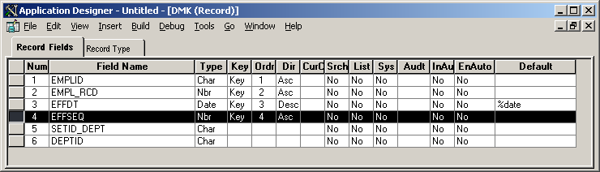
Example 1: Replicate part of JOB
Subset of columns
Across a database link from another database.

Slide 22
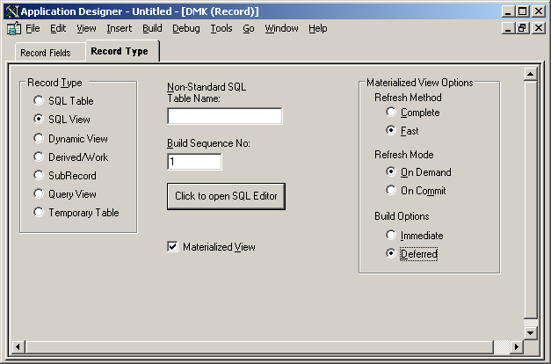
Example 1: Replicate part of JOB

Slide 23
MV Design – Thought required
Refresh method
  Complete – mandatory for complex views
  Fast – single table only, probably across DB link
Refresh mode
  On commit: could affect DML on source table
  On demand: manually issued refresh at specific point
  Scheduled: database job

Slide 24
Build Script: MV doesn’t exist (1)
DROP VIEW PS_DMK
/
CREATE VIEW PS_DMK
(EMPLID, EMPL_RCD, EFFDT, EFFSEQ, SETID_DEPT,
DEPTID)
AS SELECT EMPLID , EMPL_RCD , EFFDT , EFFSEQ , SETID_DEPT , DEPTID
FROM PS_JOB@HROTHER
/
UPDATE PSPTMATVWDEFN
SET PTMAT_MATSTAT = 0, PTMAT_REFRESHSTAT = 0,
PTMAT_LASTREFRESH = TO_TIMESTAMP('1900-01-01-00.00.00.000000'
,'YYYY-MM-DD-HH24.MI.SS.FF'), PTMAT_STALENESS = 'STALE'
WHERE RECNAME = 'DMK'
/

Slide 25
Build Script: MV doesn’t exist (2)
DELETE FROM MV_CAPABILITIES_TABLE WHERE MVNAME = 'PS_DMK'
/
DROP VIEW PS_DMK
/
CREATE MATERIALIZED VIEW PS_DMK
(EMPLID, EMPL_RCD, EFFDT, EFFSEQ,
SETID_DEPT, DEPTID)
TABLESPACE PSMATVW
BUILD DEFERRED REFRESH FAST ON DEMAND
DISABLE QUERY REWRITE
AS SELECT EMPLID , EMPL_RCD , EFFDT ,
EFFSEQ , SETID_DEPT , DEPTID FROM PS_JOB@HROTHER
/
UPDATE PSPTMATVWDEFN
SET PTMAT_MATSTAT = 1, PTMAT_REFRESHSTAT = 0,
PTMAT_LASTREFRESH = TO_TIMESTAMP('1900-01-01-00.00.00.000000'
,'YYYY-MM-DD-HH24.MI.SS.FF'), PTMAT_STALENESS = 'STALE'
WHERE RECNAME = 'DMK'
/

Slide 26
Build Script: MV exists
DROP MATERIALIZED VIEW PS_DMK
/
UPDATE PSPTMATVWDEFN SET PTMAT_MATSTAT = 0, PTMAT_REFRESHSTAT = 0, PTMAT_LASTREFRESH = TO_TIMESTAMP('1900-01-01-00.00.00.000000','YYYY-MM-DD-HH24.MI.SS.FF'), PTMAT_STALENESS = 'STALE'
WHERE RECNAME = 'DMK'
/
CREATE VIEW PS_DMK (EMPLID, EMPL_RCD, EFFDT, EFFSEQ, SETID_DEPT, DEPTID) AS
SELECT EMPLID , EMPL_RCD , EFFDT , EFFSEQ , SETID_DEPT , DEPTID FROM PS_JOB@HROTHER
/
UPDATE PSPTMATVWDEFN SET PTMAT_MATSTAT = 0, PTMAT_REFRESHSTAT = 0, PTMAT_LASTREFRESH = TO_TIMESTAMP('1900-01-01-00.00.00.000000','YYYY-MM-DD-HH24.MI.SS.FF'), PTMAT_STALENESS = 'STALE'
WHERE RECNAME = 'DMK'
/
DELETE FROM MV_CAPABILITIES_TABLE WHERE MVNAME = 'PS_DMK'
/
DROP VIEW PS_DMK
/
CREATE MATERIALIZED VIEW PS_DMK (EMPLID, EMPL_RCD, EFFDT, EFFSEQ, SETID_DEPT, DEPTID)
TABLESPACE PSMATVW BUILD IMMEDIATE REFRESH FAST ON DEMAND DISABLE QUERY REWRITE AS
SELECT EMPLID , EMPL_RCD , EFFDT , EFFSEQ , SETID_DEPT , DEPTID FROM PS_JOB@HROTHER
/
UPDATE PSPTMATVWDEFN SET PTMAT_MATSTAT = 1, PTMAT_REFRESHSTAT = 1,
(PTMAT_LASTREFRESH, PTMAT_STALENESS) = (SELECT LAST_REFRESH_DATE,
STALENESS FROM USER_MVIEWS WHERE MVIEW_NAME = 'PS_DMK') WHERE RECNAME = 'DMK'
/

Slide 27
Must have primary key on source table
Application Desigenr can only build primary key based MVs.
If source table doesn’t have primary
ORA-12014: table 'PS_JOB' does not contain a primary key constraint
  Because on remote database.
  If PT 8.48-8.53 then it may have a descending index!
You have to handle this manually
  Create materialised view log manually too.

Slide 28
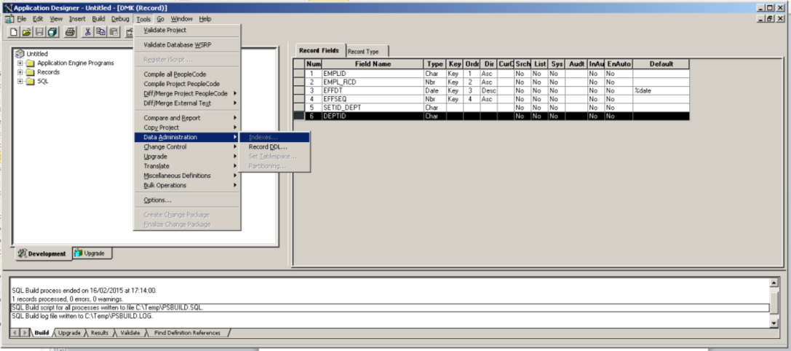
Indexing MVs
Cannot specify indexes

Slide 29
Indexing MVs
Primary key automatically inherited on single table MV replicated by MV
Alternate search columns on MV not indexed
  Must handle indexes on MV manually
Cannot define user indexes on MV
  Might be necessary because querying MV differently to base table.

Slide 30
Partitioned MVs
Not a common option, but possible
Application Designer doesn’t support partitioning on MVs

Slide 31
Example 2: Replicate part of PS_JOB locally
Create primary key on source table
Create materialised view log on source table
But
  Build script repeatedly rebuilds MV log and MV
    Could be a problem for large MV
  Generated build script alternated between dropping and building MV
    You don’t know if the build script is going to do the right thing! – clearly a bug.

Slide 32
MV Log created with additional columns
CREATE MATERIALIZED VIEW LOG
ON PS_JOB
TABLESPACE PSMATVW
WITH PRIMARY KEY
, ROWID
, SEQUENCE(DEPTID, SETID_DEPT)
INCLUDING NEW VALUES
PURGE IMMEDIATE
/

Slide 33
MV Log created with additional columns
SQL> desc mlog$_ps_job
Name Null? Type
----------------------------- -------- -------------------
EFFDT DATE
EFFSEQ NUMBER
EMPLID VARCHAR2(11 CHAR)
EMPL_RCD NUMBER
DEPTID VARCHAR2(10 CHAR)
SETID_DEPT VARCHAR2(5 CHAR)
M_ROW$$ VARCHAR2(255 CHAR)
SEQUENCE$$ NUMBER
SNAPTIME$$ DATE
DMLTYPE$$ VARCHAR2(1 CHAR)
OLD_NEW$$ VARCHAR2(1 CHAR)
CHANGE_VECTOR$$ RAW(255)
XID$$ NUMBER

Slide 34
MVs in Application Designer are more like Views than Tables!
MV and MV logs always built in tablespace PSMATVW
  I can’t find a way to control!
  I would put logs in separate tablespace to MVs
No storage clause on Materialised View
  Cannot control space allocation in block
Need attributes of a table as well as of a view

Slide 35
Example 3: MV of Security View
PS_SJT_DEPT not added to PSPTMATVWDEP
  Because has duplicate key
SELECT …
FROM PS_DEPT_TBL DEPT
, PSOPRDEFN OPR
WHERE EXISTS (
SELECT 'X'
FROM PS_SJT_DEPT SEC
, PS_SJT_CLASS_ALL CLS
, PS_SJT_OPR_CLS SOC
…)
OR EXISTS (
SELECT 'X'
FROM PS_SJT_DEPT SEC
, PS_SJT_CLASS_ALL CLS
, PS_SJT_OPR_CLS SOC
…)
OR EXISTS (
SELECT 'X'
FROM PS_SJT_DEPT SEC
, PS_SJT_CLASS_ALL CLS
, PS_SJT_OPR_CLS SOC
…)

Slide 36
Example 3: PK validation?
ALTER TABLE PS_SJT_DEPT ADD CONSTRAINT PS_SJT_DEPT_PK PRIMARY KEY (SCRTY_KEY1, SCRTY_KEY2, SCRTY_KEY3, SCRTY_TYPE_CD, SETID)
Error: DMK_DPT_SEC_MVW - SQL Error. Error Position: 39 Return: 2437 - ORA-02437: cannot validate (SYSADM.PS_SJT_DEPT_PK) - primary key violated
Application Designer worked out that PS_SJT_DEPT was referenced by the MV
But it didn’t realise that it didn’t have a unique key that could be turned into a primary key.
The error was produced because we did have duplicate data.
Complex MV doesn’t need PK on source tables for complete refresh.

Slide 37
MV_CAPABILITIES_TABLE
This produces error during script generation!
EXECUTE DBMS_MVIEW.EXPLAIN_MVIEW (q'[CREATE MATERIALIZED VIEW PS_DMK_DPT_SEC_MVW (SETID, OPRID, DEPTID, DESCR, DESCRSHORT, SETID_LOCATION, LOCATION, MANAGER_ID, COMPANY, USE_BUDGETS, USE_ENCUMBRANCES) TABLESPACE PSMATVW BUILD DEFERRED REFRESH FAST ON DEMAND AS
SELECT DEPT.SETID, OPR.OPRID, DEPT.DEPTID , DEPT.DESCR , DEPT.DESCRSHORT , DEPT.SETID_LOCATION , DEPT.LOCATION , DEPT.MANAGER_ID , DEPT.COMPANY , DEPT.USE_BUDGETS , DEPT.USE_ENCUMBRANCES FROM PS_DEPT_TBL DEPT , PSOPRDEFN OPR WHERE EXISTS ( SELECT 'X' FROM PS_SJT_DEPT SEC , PS_SJT_CLASS_ALL CLS , PS_SJT_OPR_CLS SOC WHERE SEC.SETID = DEPT.SETID AND SEC.DEPTID = DEPT.DEPTID AND SEC.EFFDT_NOKEY = DEPT.EFFDT AND CLS.SCRTY_SET_CD = 'PPLJOB' AND CLS.SCRTY_TYPE_CD = '001' AND CLS.TREE = 'Y' AND CLS.SCRTY_KEY1 = SEC.SCRTY_KEY1 AND CLS.SCRTY_KEY2 = SEC.SCRTY_KEY2 AND CLS.SCRTY_KEY3 = SEC.SCRTY_KEY3 AND SOC.OPRID

Slide 38
DBMS_MVIEW.EXPLAIN_MVIEW
SQL Build process began on 16/02/2015 at 21:05:30 for database HR92U011.
Error: Cannot create Materialized View on record DMK_JOB_CUR_MVW.
Warning: | PS_DMK_DPT_SEC_MVW | REFRESH_COMPLETE| Y | | |
Warning: | PS_DMK_DPT_SEC_MVW | REFRESH_FAST| N | | |
Warning: | PS_DMK_DPT_SEC_MVW | REWRITE| N | | |
Warning: | PS_DMK_DPT_SEC_MVW | REFRESH_FAST_AFTER_INSERT| N | aggregate function in mv | |
Warning: | PS_DMK_DPT_SEC_MVW | REFRESH_FAST_AFTER_INSERT| N | multiple instances of the same table or view | |
Warning: | PS_DMK_DPT_SEC_MVW | REFRESH_FAST_AFTER_ONETAB_DML| N | see the reason why REFRESH_FAST_AFTER_INSERT is disabled | |
Warning: | PS_DMK_DPT_SEC_MVW | REFRESH_FAST_AFTER_ANY_DML| N | see the reason why REFRESH_FAST_AFTER_ONETAB_DML is disabled | |
Warning: | PS_DMK_DPT_SEC_MVW | REWRITE_FULL_TEXT_MATCH| N | Oracle error: see RELATED_NUM and RELATED_TEXT for details |expression not supported for query rewrite |
Warning: | PS_DMK_DPT_SEC_MVW | REWRITE_FULL_TEXT_MATCH| N | Oracle error: see RELATED_NUM and RELATED_TEXT for details |expression not supported for query rewrite |
Warning: | PS_DMK_DPT_SEC_MVW | REWRITE_FULL_TEXT_MATCH| N | query rewrite is disabled on the materialized view | |
Warning: | PS_DMK_DPT_SEC_MVW | REWRITE_PARTIAL_TEXT_MATCH| N | materialized view cannot support any type of query rewrite | |
Warning: | PS_DMK_DPT_SEC_MVW | REWRITE_PARTIAL_TEXT_MATCH| N | query rewrite is disabled on the materialized view | |
Warning: | PS_DMK_DPT_SEC_MVW | REWRITE_GENERAL| N | subquery present in the WHERE clause | |
Warning: | PS_DMK_DPT_SEC_MVW | REWRITE_GENERAL| N | materialized view cannot support any type of query rewrite | |
Warning: | PS_DMK_DPT_SEC_MVW | REWRITE_GENERAL| N | query rewrite is disabled on the materialized view | |
SQL Build process ended on 16/02/2015 at 21:05:30.
1 records processed, 1 errors, 15 warnings.
SQL Build script for all processes written to file C:\Temp\PSBUILD.SQL.
SQL executed online.
SQL Build log file written to C:\Temp\PSBUILD.LOG.

Slide 39
Oracle RDBMS Feature:
Query ReWrite
If I have
  an expensive query, and
  a materialised view on the same query
Oracle can
  Rewrite the query to use the Materialised view
If
  The query on the MV is cheaper
  the view is up to date etc.

Slide 40
Example: Query ReWrite
Current department MV
CREATE MATERIALIZED VIEW PS_DMK_PER_DEP_MVW (SETID_DEPT, DEPTID, EFFDT, DESCR)
TABLESPACE PSMATVW BUILD IMMEDIATE REFRESH COMPLETE ON DEMAND
enable query rewrite
AS SELECT A.SETID ,A.DEPTID ,A.EFFDT ,A.DESCR FROM PS_DEPT_TBL A
WHERE A.EFFDT= ( SELECT MAX(B.EFFDT)
FROM PS_DEPT_TBL B
WHERE A.SETID =B.SETID
AND A.DEPTID= B.DEPTID
AND B.EFFDT<=TO_DATE(TO_CHAR(SYSDATE,'YYYY-MM-DD'),'YYYY-MM-DD'))
/

Slide 41
Example: Query ReWrite
However, expressions - in this case one generated to determine the current effective dated department - are not supported for query write.
This could limit your use of MVs.
=B.SETID AND A.DEPTID= B.DEPTID AND B.EFFDT<=TO_DATE(TO_CHAR(SYSDATE
* ERROR at line 7:
ORA-30353: expression not supported for query rewrite

Slide 42
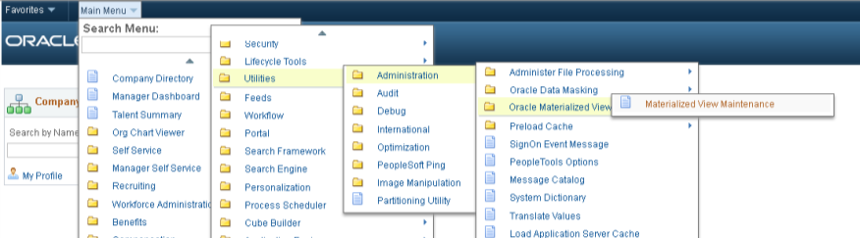
Refreshing MVs
PeopleTools►Utilities ► Administration ►Oracle Materialized Views ► Materialized View Maintenance

Slide 43
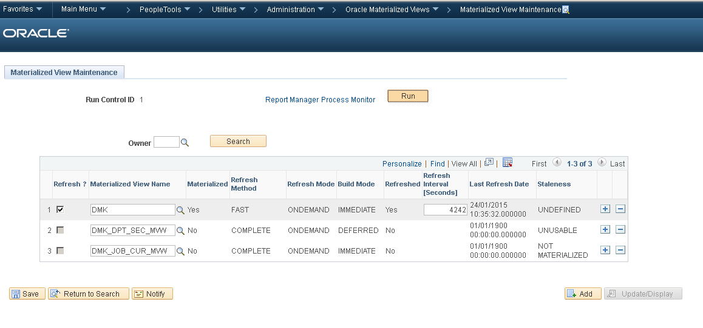
Simple MV Refresh Interval
Then run Application Engine PTMATREFVW

Slide 44
Simple MV Refresh Interval
What this AE does is
&AlterSQL = "alter materialized view " | &mview_name | " REFRESH NEXT SYSDATE + (" | &MatRecords.PTMAT_REFINT.Value | "/86400)";
What this AE does is
alter materialized view PS_DMK REFRESH NEXT SYSDATE + (4242/86400)

Slide 45
Creates a database job
select rname, next_date, interval from user_refresh
/
RNAME NEXT_DATE INTERVAL
---------- --------- -------------------------
PS_DMK 24-JAN-15 SYSDATE + (4242/86400)
select name, type, rname, job, next_date, interval from user_refresh_children
/
NAME TYPE RNAME JOB NEXT_DATE INTERVAL
---------- ---------- ---------- ---------- --------- -------------------------
PS_DMK SNAPSHOT PS_DMK 21 24-JAN-15 SYSDATE + (4242/86400)
Select job, next_date, next_Sec, interval, what from dba_jobs
/
JOB NEXT_DATE NEXT_SEC INTERVAL
---------- --------- -------- -------------------------
WHAT
--------------------------------------------------
21 24-JAN-15 11:48:52 SYSDATE + (4242/86400)
dbms_refresh.refresh('"SYSADM"."PS_DMK"');

Slide 46
MV refresh considerations
But I might want to
  Group related materialised views into a single refresh group and a single transaction.
  Run refresh the job at a particular time
    Eg. 2am every morning.
    TRUNC(SYSDATE-2/24)+1+2/24
  Refresh a materialised view at point in a batch schedule.
    Code refresh into an exisitng application engine
    Or have the application engine submit a job that only fires once and does not resubmit
      might wait for refresh

Slide 47
My MV recommendations
Good Things
  Removal of the descending indexes and creation of the primary key
  Very useful to be able to specify the materialised view query in PeopleTools.
    Easier to upgrade.
  Use of EXPLAIN_MVIEW to populate MV_CAPABILITIES_TABLE
    but the messages are obscured and should be better documented.

Slide 48
My MV recommendations
Bad Things
  No checking for non-null unique index on source table
  MV logs are totally overblown - too much data being logged.
    Additional columns are a waste of resource.
  Can't specify indexes on materialised view in Application Designer
    Primary key will be inherited automatically on single table materialised views.
    Will have to handle that manually outside PeopleTools.
  Flip-flopping of the build script is confusing
    you will never be completely sure what you have in the database.
    Too easy to drop the materialised view
      which will also drop any indexes that you have created manually!
  Not enough control over when a materialised view is refreshed.
    Just a time interval is not good enough. You probably want better control.
  It is clearly going to be difficult getting database query rewrite to work with complex materialised views in PeopleSoft.

Slide 49
My MV Conclusions
  I think some of the problems stem from
    trying to graft materialised views onto the existing view record type,
    instead of creating a new record type and building it into Application Designer properly.
    Possibly due to residual platform agnosticism in PeopleTools development?
  In most system the DBAs manage MVs
    They generally resist using PSFT specific tools
    Even more so when only half the job can be done in PeopleSoft.

Slide 50
Global Temporary Tables
Application temporarily needs a working storage tables.
  Introduced in Oracle 8i. Not separately licenced.
Global because the definition is available to everyone
Temporary because
  physical instantiation of the table is temporary
  the physical instantiation of the table is removed
    on commit preserve : when the session disconnects
    on commit delete: when the transaction is terminated
  in the temporary segment (no redo, but there is undo),
    each session gets own private copy of the table in the temp segment.
    cannot see what is in another session's temporary table
      which can make application debugging difficult.
Notes:
Global because the content is private
Temporary because the definition is permanent

Slide 51
GTT Tablespace
New feature in Oracle 11g
  Can create separate temporary tablespace and allocate GTTs to it.
    Good idea – separate from default temp space which can be eaten up by ad-hoc queries
  You must do this in PT8.54
    Oracle deliver scripts to create PSGTT01
    Specify tablespace as with any other record
    But it must be a temporary tablespace
In 12c can have a temporary undo tablespace
  Can avoid redo logging on undo on GTT

Slide 52
GTT uses
Temporary Records in AE
  Batch temporary table instances where restart disabled
    Better with stand-alone AE than PSAESRV
  All on-line temporary table instances
Can be implemented without code change
Reduction in
  Redo
  Read consistency
  High Water Mark – full scans
  RO contention with very frequent truncate

Slide 53
GTTs in PT8.54
DROP TABLE PS_ST_RM2_TAO
/
CREATE GLOBAL TEMPORARY TABLE PS_ST_RM2_TAO (PROCESS_INSTANCE
DECIMAL(10) NOT NULL,
EMPLID VARCHAR2(11) NOT NULL,
GRANT_NBR VARCHAR2(10) NOT NULL,
VEST_DT DATE,
SHARES_REMAINDER DECIMAL(21, 9) NOT NULL,
DEC_PLACES SMALLINT NOT NULL) ON COMMIT PRESERVE ROWS
TABLESPACE PSGTT01
/
CREATE UNIQUE iNDEX PS_ST_RM2_TAO ON PS_ST_RM2_TAO (PROCESS_INSTANCE,
EMPLID,
GRANT_NBR,
VEST_DT)
/

Slide 54
GTTs in PT8.54
New DDL model
select * from psddlmodel where statement_Type in(6,7);
STATEMENT_TYPE PLATFORMID SIZING_SET PARMCOUNT
-------------- ---------- ---------- ----------
MODEL_STATEMENT
------------------------------------------------------------------------
6 2 0 0
CREATE GLOBAL TEMPORARY TABLE [TBNAME] ([TBCOLLIST]) ON COMMIT PRESERVE
ROWS TABLESPACE [TBSPCNAME];
7 2 0 0
CREATE [UNIQUE] INDEX [IDXNAME] ON [TBNAME] ([IDXCOLLIST]);

Slide 55
A small problem!
Record name length limits
  Normal records: 15 characters
  Temporary record: 13 characters
  GTTs: 11 characters
    Because you can have 9999 non-shared instances
      Makes no sense, will never have that many processes
    So, cannot retrofit GTTs into some existing processes
      Eg GP_GL_SEGTMP in GP_GL_PREP

Slide 56
My Recommendation
GTTs are a welcome addition.
Long overdue.
Can bring significant benefits.
No code change required.
Just need to fix the 11 character limit

Slide 57
Partitioning
Licenced feature of Oracle Enterprise Addition.
Break a table into smaller pieces
  Certain data values only occur in certain pieces
  Optimiser can eliminate partitions because it know required data cannot be found there.

Slide 58
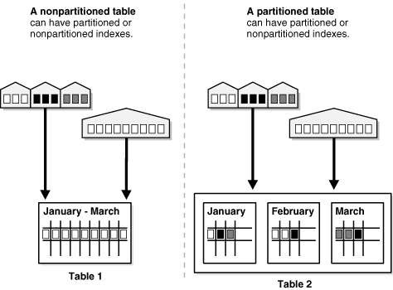
Partitioning
From Oracle 11g Database VLDB and Partitioning Guide

Slide 59

Partitioning prior to 8.54
I have to declare an interest.

Slide 60
Partitioning prior to 8.54
I have been partitioning PeopleSoft since PT7.54 and Oracle 8i
It does not invalidate your support
  (not the same as E-Business Suite!)
I have created a utility to build partition DDL script
  Managing Oracle Table Partitioning in PeopleSoft Applications with GFC_PSPART Package
    http://www.go-faster.co.uk/gfc_pspart.manual.pdf

Slide 61
Has Oracle shot my fox?
Is my partitioning utility obsolete?
How do I retrofit existing partitioning in PeopleTools?

Slide 62
Example 1: Range Partitioning PSWORKLIST
Range Partition PSWORKLIST
  On INSTSTATUS column
    Partition on Statuses 0 and 1
      Small – current active items
    Partition on Statuses 2 and 3
      Large – historical closed items
  Application frequently uses
    WHERE INSTSTATUS<2
INSTSTATUS | Description
0 | Available
1 | Selected
2 | Worked
3 | Cancelled

Slide 63
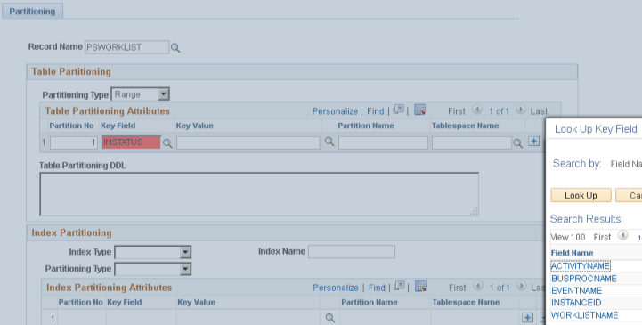
Partitioning Utility Component
PeopleTools►Utilities ►Partitioning Utility

Slide 64
Partitioning Utility Component
Can only specify key columns as partition key columns.
  Can customise PPMU_RECKEYS_VW
SELECT A.RECNAME
,A.FIELDNAME
FROM PSRECFIELDALL A /* WHERE %DecMult(%Round(%DECDIV(A.USEEDIT,2),0 ) , 2) <> A.USEEDIT*/
, PSDBFIELD B
WHERE A.FIELDNAME = B.FIELDNAME
AND B.FIELDTYPE IN(0,2,3,4,5,6)

Slide 65
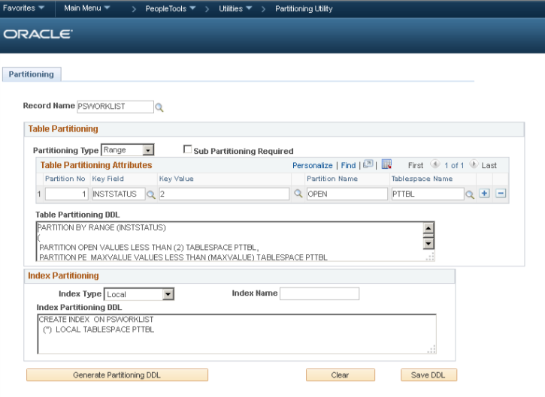
Partitioning Utility Component

Slide 66
Partitioning Utility Component
Tablespace name not mandatory
  but TABLESPACE keyword present.
MAXVALUE partition added automatically.
  Fixed 20% free space specified
Row Movement always enabled
Cannot control
  Name of MAXVALUE partition
  Tablespace of MAXVALUE partition
  Physical attributes of any partition – eg PCTFREE

Slide 67
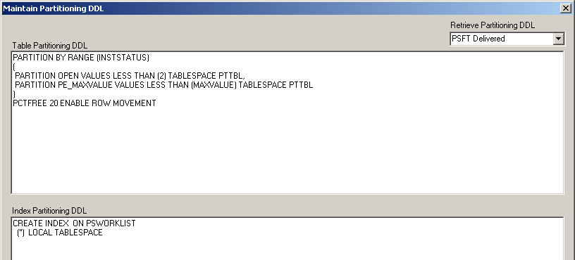
Partition DDL in Application Designer
Tools ► Data Administration ► Partitioning
Local index DDL not valid

Slide 68
DDL Script problems
CREATE INDEX PSBPSWORKLIST ON PSWORKLIST (OPRID,
INSTSTATUS)
PCTFREE 10 INITRANS 2 MAXTRANS 255 COMPUTE STATISTICS
STORAGE(INITIAL 40960 NEXT 106496 MINEXTENTS 1 MAXEXTENTS 2147483645
PCTINCREASE 0 FREELISTS 1 FREELIST GROUPS 1
BUFFER_POOL DEFAULT FLASH_CACHE DEFAULT CELL_FLASH_CACHE DEFAULT)
TABLESPACE "PSINDEX"
/
ALTER INDEX PSBPSWORKLIST NOPARALLEL LOGGING
/
CREATE INDEX PSBWORKLIST ON PSWORKLIST
('') LOCAL TABLESPACE PTTBL
/

Slide 69
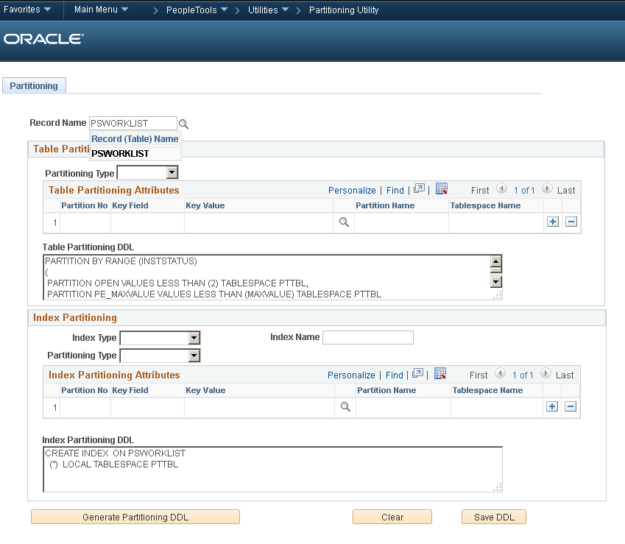
Partitioning Utility Component

Slide 70
Partitioning Utility Component
Meta-data not retained
DDL Stored in CLOB in
  PS_PTTBLPARTDDL
  PS_PTIDXPARTDDL
Other attributes are not stored
  They were typed into a derived work record
This isn’t going to help when I add/split/compress/remove partitions

Slide 71
Not integrated into Application Designer
Data Management Guide►Administering Databases on Oracle►Appendix E
"Record and index partitioning is not migrated as part of the IDE project. If you want to migrate the partitioning metadata along with the record, you will need to…" copy it yourself and it goes on to recommend creating a Data Migration Project in the Data Migration Workbench"

Slide 72
Example 2: Import Existing Partitioning
CREATE TABLE sysadm.psworklist
(busprocname VARCHAR2(30) NOT NULL
…
,descr254_mixed VARCHAR2(254) NOT NULL
)
TABLESPACE PTTBL
PCTFREE 10 PCTUSED 80
PARTITION BY RANGE(INSTSTATUS)
(PARTITION psworklist_select_open VALUES LESS THAN ('2')
,PARTITION psworklist_worked_canc VALUES LESS THAN (MAXVALUE) PCTFREE 1 PCTUSED 90
)
ENABLE ROW MOVEMENT
PARALLEL NOLOGGING
/
…
ALTER TABLE sysadm.psworklist LOGGING NOPARALLEL MONITORING
/
…
CREATE INDEX sysadm.ps0psworklist ON sysadm.psworklist
(transactionid
,busprocname
,activityname
,eventname
,worklistname
,instanceid
)
TABLESPACE PSINDEX
PCTFREE 10
PARALLEL NOLOGGING
/
…
CREATE INDEX sysadm.psbpsworklist ON sysadm.psworklist
(oprid
,inststatus
)
LOCAL
(PARTITION psworklistbselect_open
,PARTITION psworklistbworked_canc PCTFREE 1
)
TABLESPACE PSINDEX
PCTFREE 10
PARALLEL NOLOGGING
/
ALTER INDEX sysadm.psbpsworklist LOGGING
/
ALTER INDEX sysadm.psbpsworklist NOPARALLEL
/
Script created by GFC_PSPART utility

Slide 73
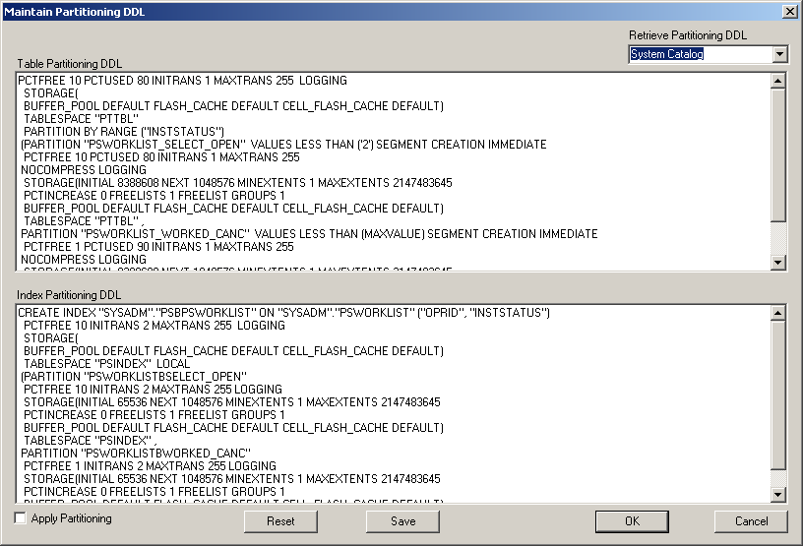
Import DDL from Oracle Catalogue

Slide 74
Example 3: Partitioning in GP_RSLT_ACUM
Main payroll result table
  I have seen systems with >1 billion rows
  Range partition on EMPLID
  Sub-partition in CAL_RUN_ID
Partitioning utility
  Cannot specify tablespace on sub-partition template
  So swapped partition keys

Slide 75
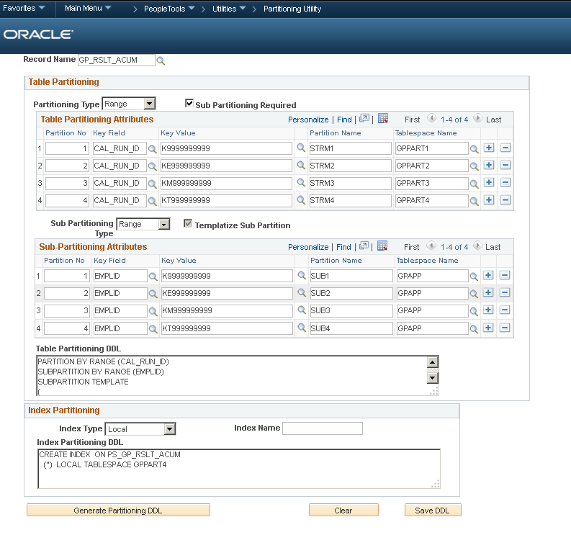

Slide 76
Generated DDL uses template syntax
PARTITION BY RANGE (CAL_RUN_ID)
SUBPARTITION BY RANGE (EMPLID)
SUBPARTITION TEMPLATE
(
SUBPARTITION SUB1 VALUES LESS THAN ('K9999999999'),
SUBPARTITION SUB2 VALUES LESS THAN ('KE999999999'),
SUBPARTITION SUB3 VALUES LESS THAN ('KM999999999'),
SUBPARTITION SUB4 VALUES LESS THAN ('KT999999999') ,
SUBPARTITION PE_MAXVALUE VALUES LESS THAN (MAXVALUE)
)
(
PARTITION STRM1 VALUES LESS THAN ('K9999999999') TABLESPACE GPPART1,
PARTITION STRM2 VALUES LESS THAN ('KE999999999') TABLESPACE GPPART2,
PARTITION STRM3 VALUES LESS THAN ('KM999999999') TABLESPACE GPPART3,
PARTITION STRM4 VALUES LESS THAN ('KT999999999') TABLESPACE GPPART4,
PARTITION PE_MAXVALUE VALUES LESS THAN (MAXVALUE) TABLESPACE GPPART4
)
PCTFREE 20 ENABLE ROW MOVEMENT

Slide 77
Partitioning in Global Payroll
In GP with GB extensions
  45 similarly range partitioned tables
  2 – 6 of which are sub partitioned
I want define a single partitioning strategy
  Apply it to 45 tables.

Slide 78
My opinion
This utility doesn’t help me manage a complex partitioning strategy over time.
I had expected an extension to the structured metadata in the PeopleTools tables.
  None of the attributes that I enter are stored. They are lost when I leave the component.
  What we have is a one time DDL generator, and then we store the DDL
The partitioning utility component doesn’t do much I can’t do with a text editor

Slide 79
%SQLHint Meta-SQL
Processed after all other expansions and meta-SQL
  Searches SQL string
  finds n^{th} occurrence of SQL keword
  Inserts a string after it
Particularly effective with %InsertSelect() meta-SQL.
Advantage for Oracle’s own developers
  Platform specific hints

Slide 80
Prior to 8.54
This is how to hint %InsertSelect
%InsertSelect(DISTINCT, DMK,JOB J,
EMPLID= /*+LEADING(J)*/ J.EMPLID)
FROM PS_JOB J
This example shows why it can fail
  The hint is in the wrong place
INSERT INTO PS_DMK
(EMPLID, EMPL_RCD, EFFDT, EFFSEQ, SETID_DEPT, DEPTID)
SELECT DISTINCT /*+LEADING(J)*/ J.EMPLID, J.EMPL_RCD, J.EFFDT, J.EFFSEQ, J.SETID_DEPT, J.DEPTID
FROM PS_JOB J
…

Slide 81
Contrived Example
%SqlHint(INSERT,1,'/*+APPEND*/',ORACLE,ENABLE) %SqlHint(INSERT,1,'/*Developer Comment*/',ORACLE,DISABLE) %SqlHint(SELECT,1,'/*+LEADING(J)*/',ORACLE) %SqlHint(SELECT,2,'/*+UNNEST(J1)*/',ORACLE) %SqlHint(SELECT,3,'/*+UNNEST(J2)*/',ORACLE) %InsertSelect(DISTINCT, DMK,JOB J)
FROM PS_JOB J
WHERE %Sql(DMK_CURJOB,JOB,J,J1,J2)
SQL object that contains EFFDT and EFFSEQ subqueries
Insert in Direct Path Mode
Disabled Hint is a nice way to get a comment into the code but not the SQL
Leading hint in main query
Unnest hints into sub-query in SQL object

Slide 82
Result of Contrived Example
INSERT /*+APPEND*/ INTO PS_DMK (EMPLID
, EMPL_RCD
, EFFDT
, EFFSEQ
, SETID_DEPT
, DEPTID)
SELECT /*+LEADING(J)*/ DISTINCT J.EMPLID
, J.EMPL_RCD
, J.EFFDT
, J.EFFSEQ
, J.SETID_DEPT
, J.DEPTID
FROM PS_JOB J
WHERE J.EFFDT = (
SELECT /*+UNNEST(J1)*/ MAX(J1.EFFDT)
FROM JOB J1
WHERE J1.EMPLID = J.EMPLID
AND J1.EMPL_RCD = J.EMPL_RCD
AND J1.EFFDT <= TO_DATE(TO_CHAR(SYSDATE,'YYYY-MM-DD'),'YYYY-MM-DD'))
AND J.EFFSEQ = (
SELECT /*+UNNEST(J2)*/ MAX(J2.EFFSEQ)
FROM JOB J2
WHERE J2.EMPLID = J.EMPLID
AND J2.EMPL_RCD = J.EMPL_RCD
AND J2.EFFDT = J.EFFDT)

Slide 83
Plan Stability in Oracle
Oracle has various technologies to control execution plan
  SQL Outlines
  SQL Profiles
  SQL Patches
  SQL Baselines
Application Engine can defeat these
  Different temporary table instances
  Dynamic code
  Migration of plan stability with code changes

Slide 84
Conclusion
Excellent new feature
Simple
Effective
I look forward to hint the places that other techniques cannot reach!

Slide 85


Slide 86
%SelectDummyTable Meta-SQL
Simply evaluates to DUAL
Dual is a convenience table that provides a single row
  PeopleSoft often uses PS_INSTALLATION
  Dual is not a table, but a memory structure
    It doesn’t even require a logical read.
  Removes risk that PS_INSTALLATION has 0 or many rows.

Slide 87
Example
Instead of (see ESPP_REF_REVMAIN.PSHUP.Do When)
%Select(IF_FLAG)
SELECT 'X'
FROM PS_INSTALLATION
WHERE %Bind(ST_SEND_SRC) = 'N'
Code this
%Select(IF_FLAG)
SELECT 'X'
FROM %SelectDummyTable
WHERE %Bind(ST_SEND_SRC) = 'N'
Which resolves to
%Select(IF_FLAG)
SELECT 'X'
FROM DUAL
WHERE %Bind(ST_SEND_SRC) = 'N'

Slide 88
Conclusion
Small, simple improvement
I would not change code just to get this in, but I would use it going forward

Slide 89
Multiple Security Records
This is new behaviour in PeopleTools 8.54
  that could impact database performance
Release notes:
  “PeopleTools has added an Advanced Query Security option to Application Designer. This feature allows up to five Query Security Records to be associated with a single record, including the ability to associate security with non-key fields.
  “While powerful, this feature should be used sparingly because multiple additional joins will affect query performance.”

Slide 90
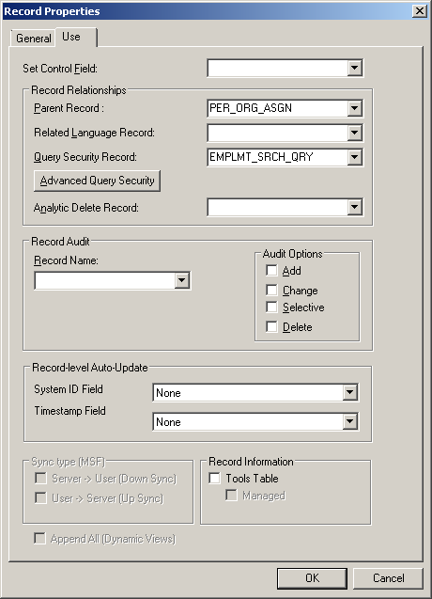
Query Security prior to PT8.54
Security record joined in query by key columns in common

Slide 91
PS/Query SQL
SELECT B.EMPLID, B.DEPTID
FROM PS_JOB B, PS_EMPLMT_SRCH_QRY B1, PS_NAMES A, PS_PERALL_SEC_QRY A1
WHERE ( B.EMPLID = B1.EMPLID
AND B.EMPL_RCD = B1.EMPL_RCD
AND B1.OPRID = 'PS'
AND A.EMPLID = A1.EMPLID
AND A1.OPRID = 'PS'
AND ( B.EFFDT =
(SELECT MAX(B_ED.EFFDT) FROM PS_JOB B_ED
WHERE B.EMPLID = B_ED.EMPLID
AND B.EMPL_RCD = B_ED.EMPL_RCD
AND B_ED.EFFDT <= SYSDATE)
AND B.EFFSEQ =
(SELECT MAX(B_ES.EFFSEQ) FROM PS_JOB B_ES
WHERE B.EMPLID = B_ES.EMPLID
AND B.EMPL_RCD = B_ES.EMPL_RCD
AND B.EFFDT = B_ES.EFFDT)
AND B.EMPLID = A.EMPLID
AND A.EFFDT =
(SELECT MAX(A_ED.EFFDT) FROM PS_NAMES A_ED
WHERE A.EMPLID = A_ED.EMPLID
AND A.NAME_TYPE = A_ED.NAME_TYPE
AND A_ED.EFFDT <= SYSDATE) ))
Join on key columns in common
Multiple query security records often cause performance problems

Slide 92
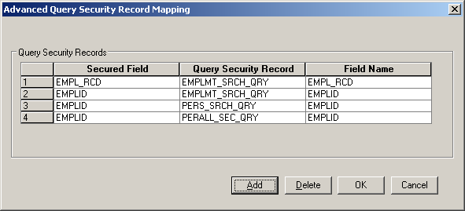
Multiple Query Security records
Can specify join columns
  Stored in PSRECSECFLDMAPS.

Slide 93
PS/Query with multiple security records
SELECT B.EMPLID, B.DEPTID
FROM PS_JOB B, PS_EMPLMT_SRCH_QRY B1, PS_EMPLMT_SRCH_QRY B4, PS_PERALL_SEC_QRY B5, PS_PERS_SRCH_QRY B6, PS_NAMES A, PS_PERALL_SEC_QRY A1
WHERE ( B.EMPLID = B1.EMPLID
AND B.EMPL_RCD = B1.EMPL_RCD
AND B1.OPRID = 'PS'
AND B.EMPLID = B4.EMPLID
AND B.EMPL_RCD = B4.EMPL_RCD
AND B4.OPRID = 'PS'
AND B.EMPLID = B5.EMPLID
AND B5.OPRID = 'PS'
AND B.EMPLID = B6.EMPLID
AND B6.OPRID = 'PS'
AND A.EMPLID = A1.EMPLID
AND A1.OPRID = 'PS'
AND ( B.EFFDT =
(SELECT MAX(B_ED.EFFDT) FROM PS_JOB B_ED
WHERE B.EMPLID = B_ED.EMPLID
AND B.EMPL_RCD = B_ED.EMPL_RCD
AND B_ED.EFFDT <= SYSDATE)
AND B.EFFSEQ =
(SELECT MAX(B_ES.EFFSEQ) FROM PS_JOB B_ES
WHERE B.EMPLID = B_ES.EMPLID
AND B.EMPL_RCD = B_ES.EMPL_RCD
AND B.EFFDT = B_ES.EFFDT)
AND B.EMPLID = A.EMPLID
AND A.EFFDT =
(SELECT MAX(A_ED.EFFDT) FROM PS_NAMES A_ED
WHERE A.EMPLID = A_ED.EMPLID
AND A.NAME_TYPE = A_ED.NAME_TYPE
AND A_ED.EFFDT <= SYSDATE) ))
A1 & B1 are original query security records
B4, B5 and B6 are new query security records
EMPLMT_SRCH_QRY was joined twice

Slide 94
Conclusion
Multiple query security records can be cause of performance problems
  Must be serious if the release notes mentions it.
  Useful if joining security on non-key field
  Otherwise I might prefer to merge security views

Slide 95
Oracle Resource Manager
Resource Manager
  Restricting sessions
  Prioritising one database session over another
Resource Plan
  Set of rules applied to some or all sessions
  Must reflect business priorities
  Requires careful design

Slide 96
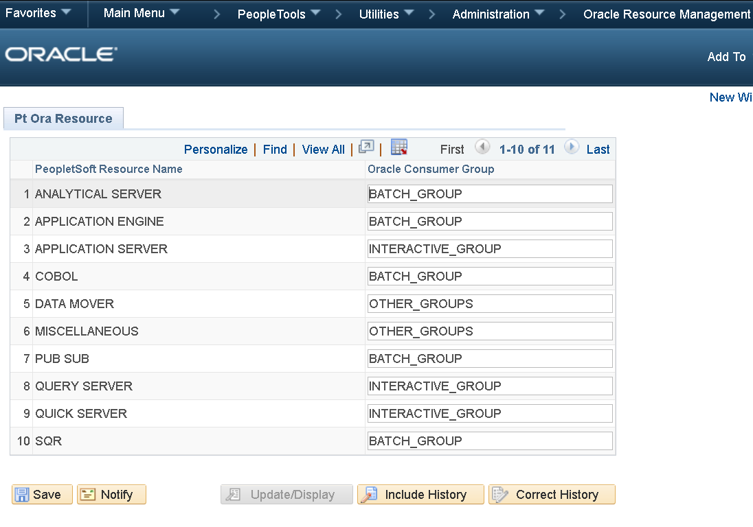
Oracle Resource Manager in PeopleTools 8.54

Slide 97
PeopleSoft Executable →Resource Map
At process startup lookup process on PS_PTEXEC2RESOURCE
SELECT PT_ORA_CONSUMR_GRP
FROM PS_PT_ORA_RESOURCE
, PS_PTEXEC2RESOURCE
WHERE PT_EXECUTABLE_NAME = 'PSAPPSRV'
AND PT_ORA_CONSUMR_GRP <> ' '
AND PS_PT_ORA_RESOURCE.PT_RESOURCE_NAME = PS_PTEXEC2RESOURCE.PT_RESOURCE_NAME
PT_ORA_CONSUMR_GRP
------------------------
INTERACTIVE_GROUP
And then explicity switch group

Slide 98
PS_PTEXEC2RESOURCE Mappings
I question one or two of the mappings on PS_PTEXEC2RESOURCE
  Which you could change
SELECT * FROM PS_PTEXEC2RESOURCE …
PT_EXECUTABLE_NAME PT_RESOURCE_NAME
-------------------------------- ------------------
…
PSAPPSRV APPLICATION SERVER
PSNVS MISCELLANEOUS
PSQED MISCELLANEOUS
PSQRYSRV QUERY SERVER
…

Slide 99
Oracle Resource Manager
Explicit switch overrides any automatic switches by session attribute.
Cannot mix
  PeopleSoft Consumer Groups &
  Oracle Consumer Group Mappings
    Eg. By MODULE/ACTION
    Resource group for a particular component
    Would have to delete mapping from PS_PTEXEC2RESOURCE

Slide 100
Consumer Group Mapping
BEGIN
DBMS_RESOURCE_MANAGER.CREATE_PENDING_AREA();
DBMS_RESOURCE_MANAGER.SET_CONSUMER_GROUP_MAPPING
(attribute => 'MODULE_NAME'
,value => 'PROCESSMONITOR'
,consumer_group => 'SYS_GROUP');
DBMS_RESOURCE_MANAGER.SUBMIT_PENDING_AREA();
END;
/

Slide 101
Consumer Group Mapping Priority
BEGIN
DBMS_RESOURCE_MANAGER.set_consumer_group_mapping_pri (
explicit => 1,
oracle_user => 2,
service_name => 3,
client_os_user => 4,
client_program => 5,
client_machine => 6,
module_name_action => 7,
module_name => 8,
service_module_action => 9,
service_module => 10
);
END;
/
Explicit must be priority 1

Slide 102
Conclusion
A good start, but need more granularity.
Specify consumer group by
  Specific scheduled process
  Application server domain
    Eg PIA –v- IB –v- nVision
    Eg. Back office –v- Self Service
  Useful on RAC
  Essential on Multi-tenant

Slide 103
Performance Monitor enhancements
Transaction history component search
  Multiple systems
  Multiple transaction types
Tuxedo Queuing reported
  Fixed in 8.53?
Improvements to Archive/Purge process
JMX support for connection to OEM?

Slide 104
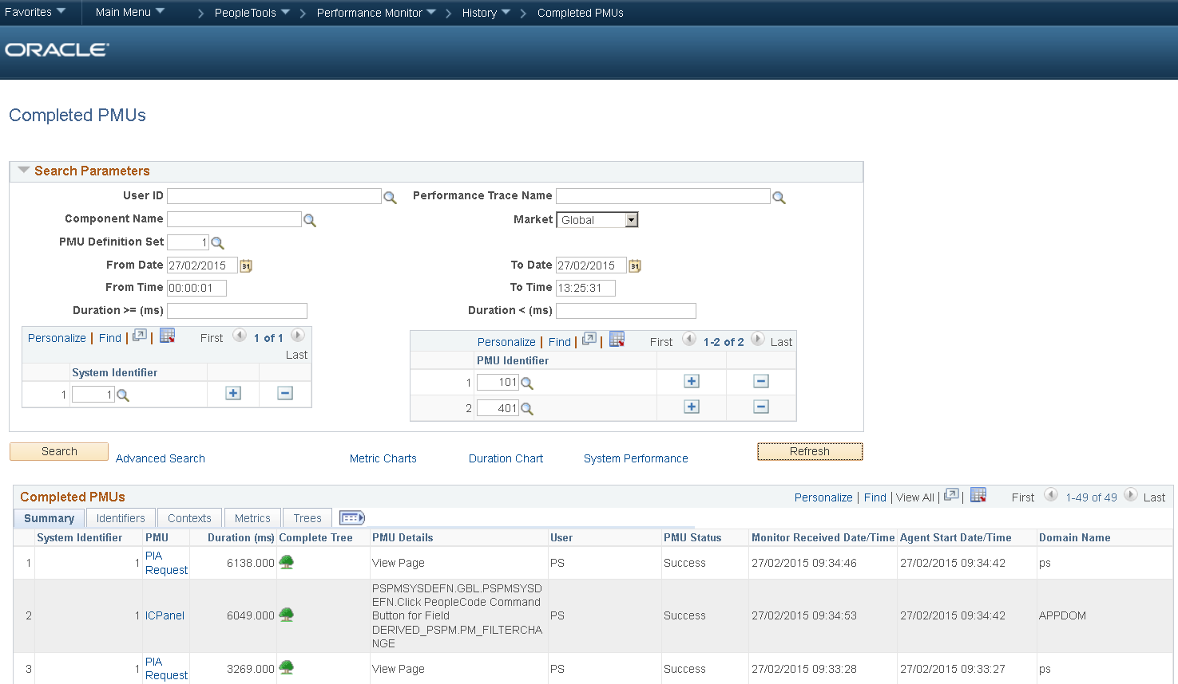

Slide 105
EnableAEMonitoring
Application Engine Instrumentation
  Calls to DBMS_APPPLICATION_INFO
  Disabled by default from PT8.52.23 & PT8.53.13
    Performance degradation in DO LOOP processing
  New Parameter to reenable
Oracle Bug 10130415 Latch contention on "resmgr group change latch“
  Fixed 11.2.0.3

Slide 106
New Parameter in psprcs.cfg
New Parameters to re-enable instrumentation.
  This is highly recommended
[Database Options] ;=========================================================================
; Database-specific configuration options ;=========================================================================
…
;DMK - added to enable DBMS_APPLICATION_INFO instrumentation
EnableAEMonitoring=1

Slide 107
Conclusion
Lots of new performance/management features in PT8.54
  Clear move away from platform agnosticism in favour of explicit support for Oracle RDBMS features.
  Some have some rough edges
  Some require more development
It will be a while before we see some of them used in delivered code.
  We can start to use them now.

Slide 108
Questions?

Slide 109
Conclusion
Lots of new performance/management features in PT8.54
  Clear move away from platform agnosticism in favour of explicit support for Oracle RDBMS features.
  Some have some rough edges
  Some require more development
It will be a while before we see some of them used in delivered code.
  We can start to use them now.

